Slide 1
JAVA PROJECT
by
Shreeprada Bhat

Slide 2
TOPIC
Multilevel priority queue

Slide 3
IMPLEMENTATION
as multilevel priority queue scheduler

Slide 4
APPROACH
Our view is implement it as scheduler as in operating system
The project will comprise of showing a simulator for multilevel priority queue scheduling.

Slide 5
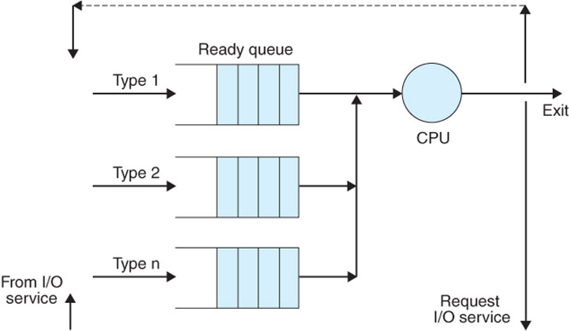
PICTORIALLY

Slide 6
BASIC IDEA
Each process is assigned a priority, the user will input the priority
The output will be execution of job with highest priority
New processes begin in highest priority queue,a process is rewarded by moving it to a higher priority queue
Higher priority queues must be emptied before processes from lower priority queues are allowed to run

